Slide 1
Chapter 2
File system and some File handling commands

Slide 2
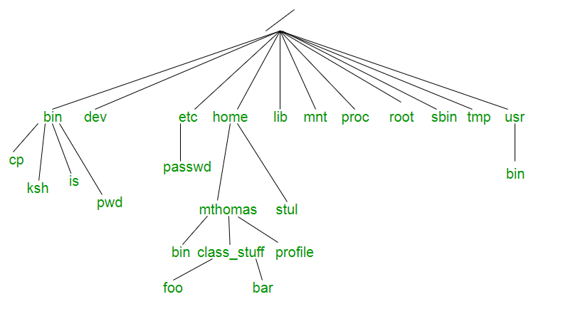
The File:
File in Unix system is a multi-level hierarchy structure known as a directory tree.
Each file in a given directory must be unique.
Unix is Case Sensitive.

Slide 3
Most files are just files, called regular files; they contain normal data.
Eg: Text files, executable files or programs, input for or output from a program and so on.
Directories: files that are lists of other files.
Special files or Device Files:
To read or write a device, you have to perform these operations on its associated file. Most special files are in /dev.
Links:
A system to make a file or directory visible in multiple parts of the system's file tree.

Slide 4
(Domain) sockets:
A special file type, similar to TCP/IP sockets, providing inter-process networking protected by the file system's access control.
Named pipes:
It act as more or less like sockets and form a way for processes to communicate with each other, without using network socket semantics.
Types of file:
Ordinary (Regular) File:
It can be either a text file or a binary file.

Slide 5
Binary file contains both printable & nonprintable characters that cover the entire ASCII range.
The object code and executables that you produce by compiling C programs are binary files.
b) Directory File:
A directory file contains one entry for every file and subdirectory that it houses.
Each entry has 2 components : Filename & Unique identification number of the file or directory.
When we create or remove a file, the kernel automatically updates its corresponding directory by adding or removing the entry (filename and inode number) associated with the file.

Slide 6
c) Device File:
They appear in a file system just like an ordinary file or a directory.
It is the attributes of the file that entirely govern the operation of the device.
The kernel identifies a device from its attributes and uses them to operate the device.
Absolute path:
It is defined as the specifying the location of a file or directory from the root directory(/).
Eg: /boot/grub/grub.conf

Slide 7
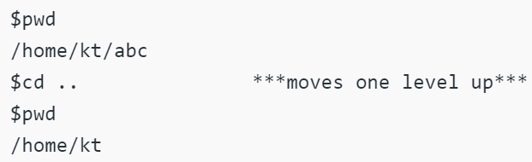
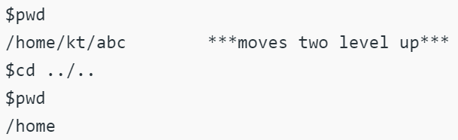
Relative path:
It is defined as path related to the present working directory(pwd).
UNIX offers a shortcut in the relative pathname that uses either the current or parent directory as reference and specifies the path relative to it.
.(a single dot) - this represents the current directory.
..(two dots) - this represents the parent directory.

Slide 8
The HOME variable:
When we log onto the system, UNIX automatically places in a directory called the home directory.
The shell variable HOME indicates the home directory of the user.
Eg: $ echo $HOME
/home/kumar
pwd - print working directory:
pwd determines where you are in the file system hierarchy.
Eg: $pwd
/home/frank/src

Slide 9
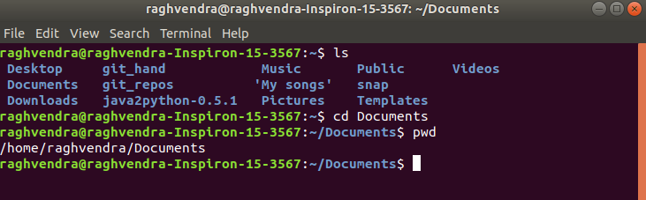
cd - change directory:
It accepts both absolute and relative path names.
Syntax: cd [directory]
Eg:
cd changes to user's home directory

Slide 10
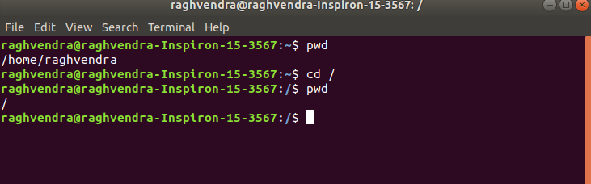
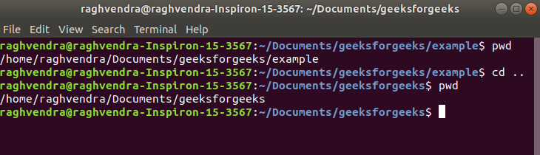
cd / : To change directory to the root directory
cd .. :goes up one directory level
cd ../.. :goes up two directory levels

Slide 11
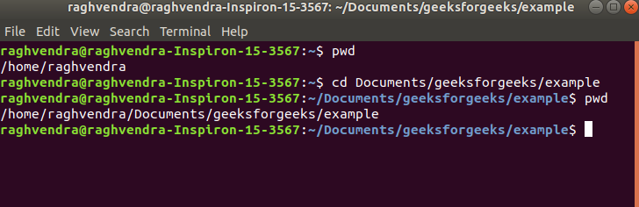
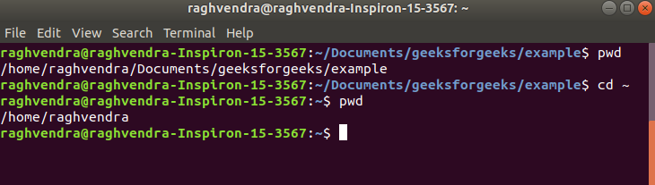
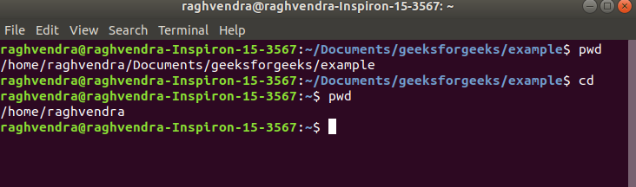
cd dir_1/dir_2/dir_3: This command is used to move inside a directory from a directory
cd ~ : this command is used to change directory to the home directory.

Slide 12
mkdir - make a directory:
The parent directory should be specified first, followed by the subdirectories to be created under it.
Eg:
mkdir patch
mkdir patch dbs doc
mkdir sample sample/pgms sample/data
System may refuse to create a directory due to the following reasons:
The directory already exists.
There may be an ordinary file by the same name in the current directory.
The permissions set for the current directory don’t permit the creation of files and directories by the user.

Slide 13
rmdir - remove directory:
We can’t remove a directory if it is your present working directory.
Eg:
rmdir patch : Directory must be empty
rmdir pis pis/progs pis/data : Shows error as pis is not empty.
The PATH environment variable:
Environmental variables are used to provide information to the programs you use.
A command runs in UNIX by executing a disk file.

Slide 14
When we specify date command, system will locate the associated file from a list of directories specified in the PATH variable and then executes it.
The system goes through the following steps in order to determine which program to execute:
Built in commands (such as cd and history) are executed within the shell.
If an absolute path name (such as /bin/ls) or a relative path name (such as ./myprog), the system executes the program from the specified directory.
Otherwise the PATH variable is used.

Slide 15
ls - list directory contents:
Syntax: ls [options] [argument]
Options:
-a Lists all files, including those beginning with a dot (.).
-d Lists only names of directories, not the files in the directory
-F Indicates type of entry with a trailing symbol: executables with *, directories with / and symbolic links with @
-R lists all files recursively from current directory
-u Sorts filenames by last access time
-t Sorts filenames by last modification time

Slide 16
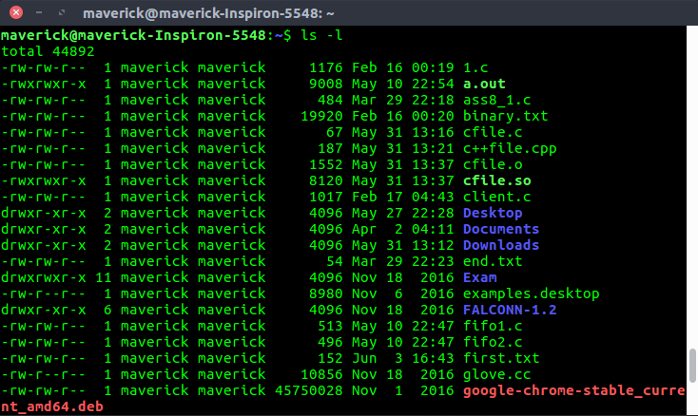
-i Displays inode number
-l Long listing: lists the mode, link information, owner, size, last modification (time).

Slide 17
-rw-rw-r– 1 maverick maverick 1176 Feb 16 00:19 1.c
1st Character – File Type:
Possible file type options in the 1st character of the ls -l output.
Field Explanation:
a) – normal file
b) d : directory
c) s : socket file
d) l : link file
Field 1 – File Permissions:
Next 9 character specifies the files permission.
rw-rw-r– indicates read-write permission for user(root) , read permission for group, and no permission for others respectively.

Slide 18
Field 2 – Number of links:
Eg: 1 indicates only one link to this file.
Field 3 – Owner:
Eg: file is owned by username ‘maverick’.
Field 4 – Group:
Eg: file belongs to ”maverick’ group.
Field 5 – Size:
Eg: ‘1176’ indicates the file size in bytes.
Field 6 – Last modified date and time:
Eg: ‘Feb 16 00:19’ specifies the last modification time of the file.

Slide 19
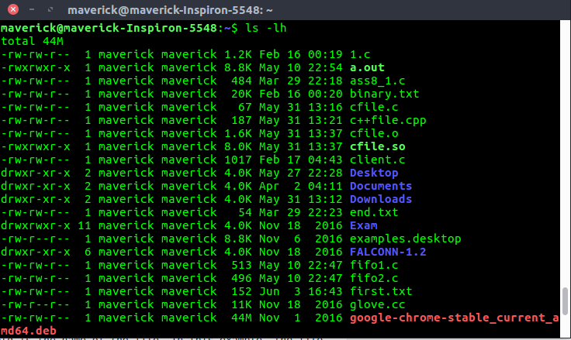
Field 7 – File name:
Eg: File name is 1.c.
ls -lh (h stands for human readable form):

Slide 20
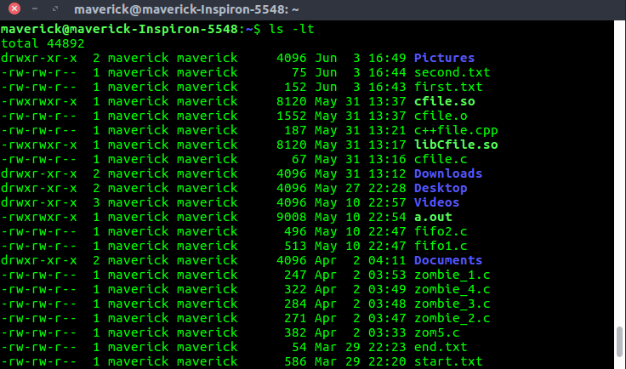
ls -lt :
$ ls -ltr :

Slide 21
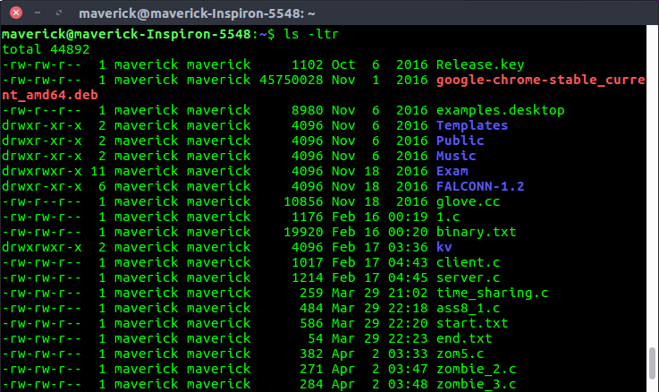
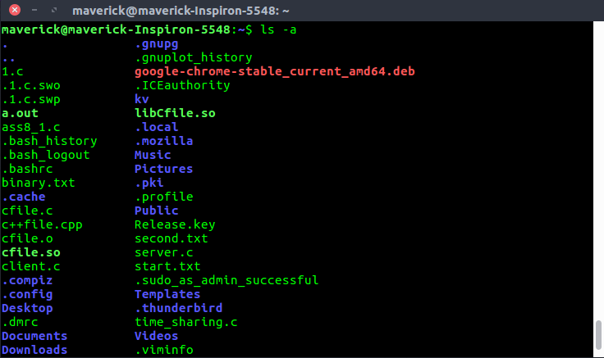
$ ls -a :

Slide 22
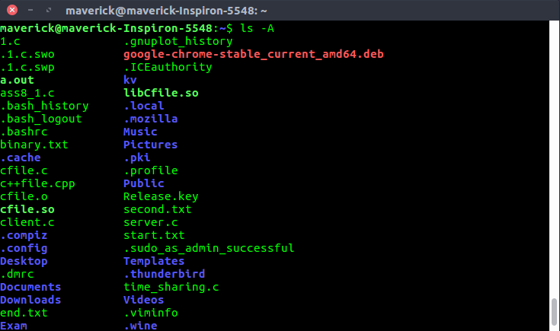
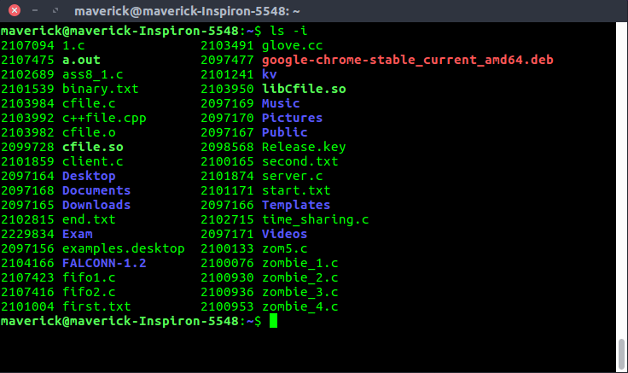
$ ls -A :
$ls –i:

Slide 23
The UNIX File System:
Some subdirectories contained under root:
Directory | Content
/bin | Common programs, shared by the system, the system administrator and the users.
/dev | Contains references to all the CPU peripheral hardware, which are represented as files with special properties.
/etc | Most important system configuration files are in /etc, this directory contains data similar to those in the Control Panel in Windows
/home | Home directories of the common users.
/lib | Library files, includes files for all kinds of programs needed by the system and the users.
/sbin | Programs for use by the system and the system administrator.
/tmp | Temporary space for use by the system, cleaned upon reboot, so don't use this for saving any work!
/usr | Programs, libraries, documentation etc. for all user-related programs.
/var | Storage for all variable files and temporary files created by users, such as log files, the mail queue, the print spooler area, space for temporary storage of files downloaded from the Internet, or to keep an image of a CD before burning it.

Slide 24
cat: Displaying and Creating Files:
Syntax: cat [options] [filenames]
Display contents of file : Eg: cat file1
Eg: cat file1 | less
Numbering Lines (-n): Used to display numbered lines.
cat for file creation: cat > file1
cat file1 file2 >file3 concatenate two files into the third file

Slide 25
cat is used to create the file with content.
touch: used to create the empty files in Unix system.
Syntax: touch file_name
touch File1_name File2_name File3_name
touch –a used to change access time only
touch –m used to change the modification time only.
touch -t Used to create a file using a specified time.
Syntax: touch -t YYMMDDHHMM fileName

Slide 26
cp: Copying files:
Syntax: cp [OPTION] source destination
Eg: cp A.c Z.c
rm: Deleting files:
Eg: rm chap01 chap02 chap03
* represents all files. Eg: rm *
Interactive deletion (-i): Eg: rm –i chap01 chap02 chap03
Force Deletion (-f): Eg: rm –f chap01

Slide 27
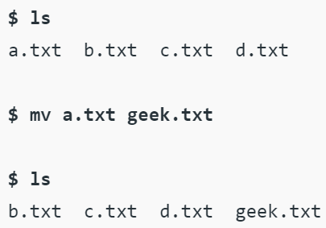
$rm –rf
mv: Renaming files:
Syntax: mv [Option] source destination
mv does not create a copy of the file; it merely renames it.
mv does not prompt for overwriting the existing file

Slide 28
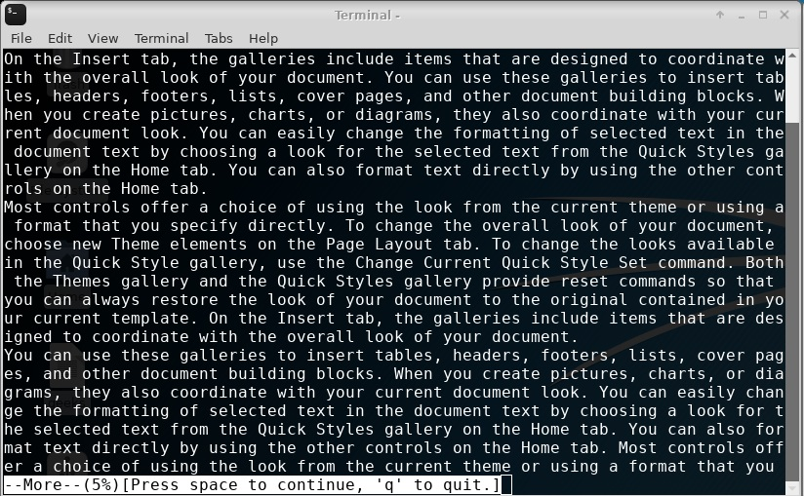
more: Paging Output:
More displays one screen at a time in case the file is large
more command hit the space bar to see more or q to quit.
Eg: more -d sample.txt

Slide 29
The lp subsystem: Printing a File:
The spooling facility is provided by the lp(line printing) command.
Default printer is defined by administrator. If printer has been defined the lp runs fine.
If printer is not defined or if more than one printers are defined, we need to use -d with the printer name:
Eg: lp –dlaser chap01.ps
lp –t “First Chapter” chap01.ps
After file has been printed, we can notify user with –m (mail) option.

Slide 30
lp –n3 –m chap01.ps //Prints 3 copies & mails user a message
lp rfc822.ps //postscript file
Request id is pr1-320 (1 file)
$_
The file is not printed at the time the command is invoked, by depending on number of jobs already lined up in the queue.
lp notifies request id a combination of printer name (pr1) and job number (320) which can be later accessed with other commands.
cancel laser //cancels current job on printer laser
cancel pr1-320 //cancels job with request-is pr1-320

Slide 31
file: Knowing the File Types:
To know more about 3 types files, we use file command.
Eg: file archive.zip
File correctly identifies the basic file types.
Eg: file *

Slide 32
wc: Counting Lines, words and characters:
It takes one or more filenames as arguments and displays a four columnar output
Syntax: wc filename
Options:
-l Counts the number of lines
-w Counts the number of words
-c Counts the number of characters

Slide 33
od: Displaying Data in Octal:
It can display output in a variety of other formats including hexadecimal, decimal, and ASCII.
It is useful for visualizing data that is not in a human-readable format, like the executable code of a program.
Syntax: od [OPTION] [FILE]
Eg: od –bc file1
Options:
-b : Displays the contents of input in octal format.
-c : Displays the contents of input in character format.

Slide 34
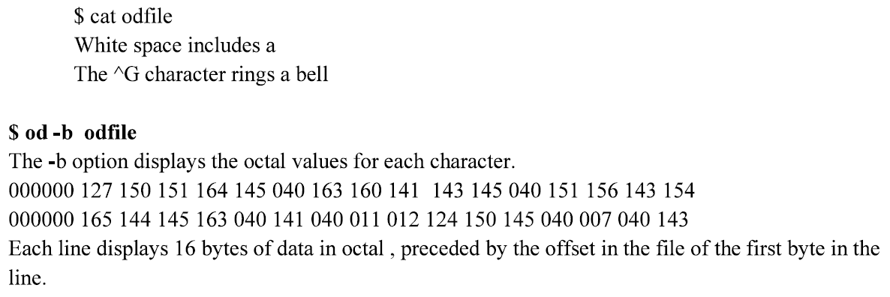
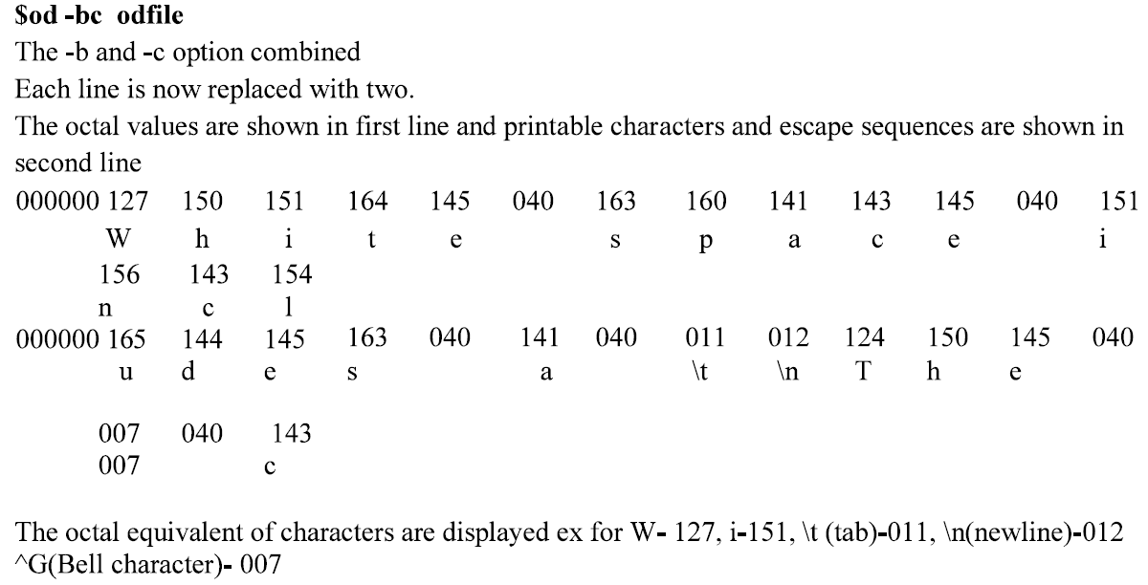

Slide 35
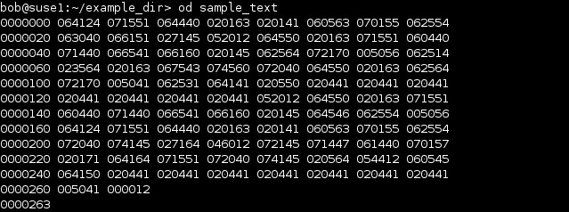
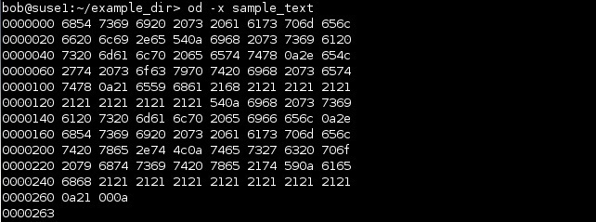
We can display this file in octal format by using the od command without any options:
od –x:

Slide 36
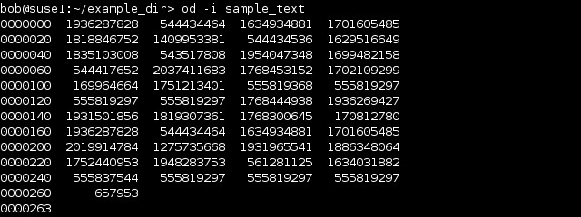
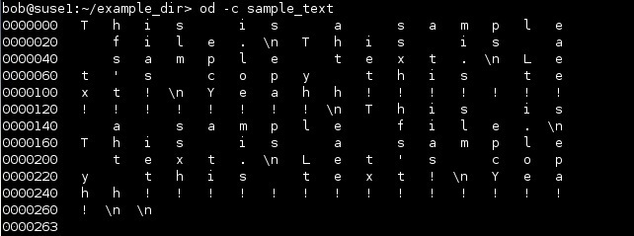
od –i:
od –c:

Slide 37
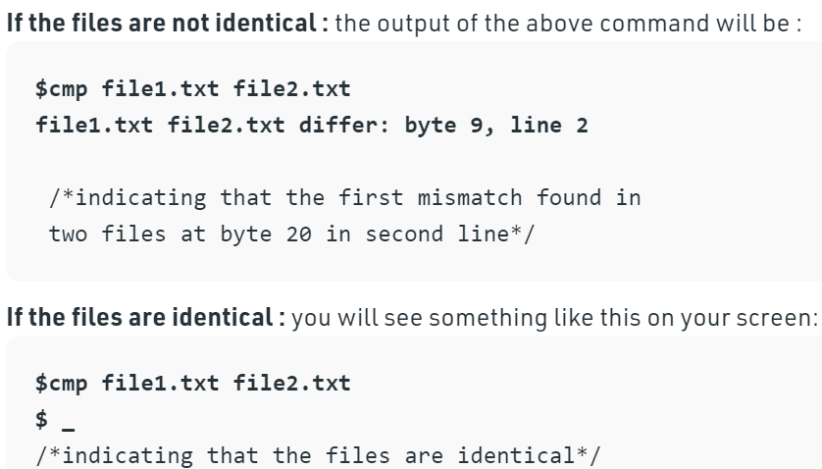
cmp: Comparing two files:
It is used to compare the two files byte by byte and helps to find out whether the two files are identical or not.
Eg: cmp chap01 chap02

Slide 38

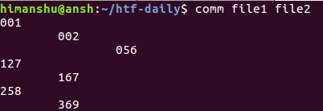

comm: What is Common?
It is Unix family of computer operating systems is a utility that is used to compare two files for common and distinct lines.
comm outputs one file, which contains three columns.
Syntax: comm [name-of-first-file] [name-of-second-file]
Eg: Suppose 'file1' and 'file2' are 2 files. The file1 contains:
file 2 contains:

Slide 39
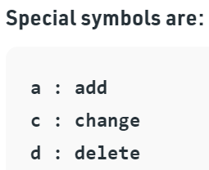
diff: Converting one file to other:
It is a file comparison utility that outputs the differences between two files.
Syntax: diff file1 file2
diff uses certain special symbols and instructions that are required to make two files identical.
It tells you the instructions on how to change the first file to make it match the second file.

Slide 40
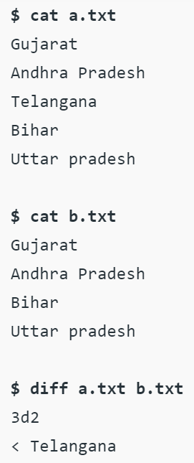

Slide 41
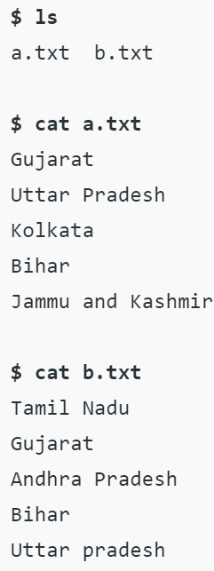
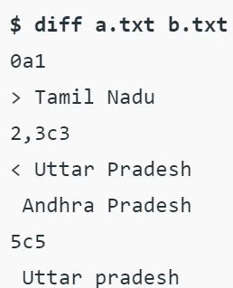

Slide 42
Thank You

